Slide 1
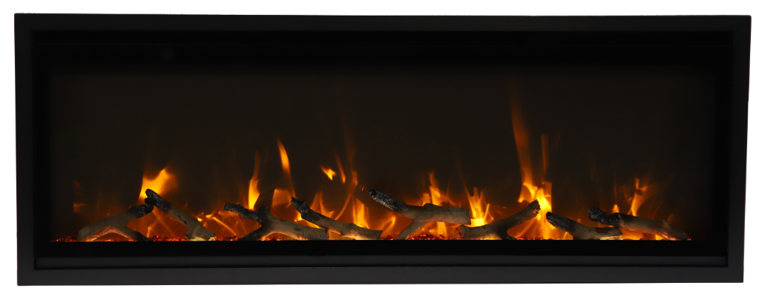
Symmetry- Xtraslim – Repair Guide
(Sym Slim)
SYMMETRY XTRASLIM SERIES

Slide 2
Content
Replacing the tray light
Replacing the flame light
Replacing the flicker motor
Replacing the heating element
Replacing the PCB board
Replacing the signal receiver
Replacing the touch control panel

Slide 3
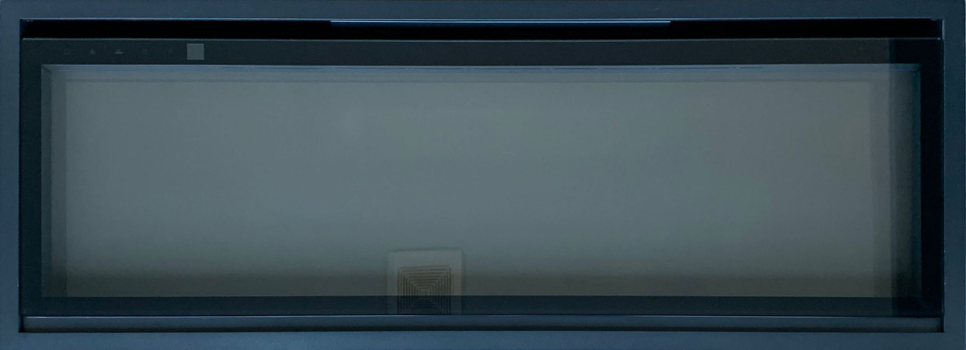
Replacing the tray light
Step 1
Slightly push the glass upward to remove the front glass.

Slide 4
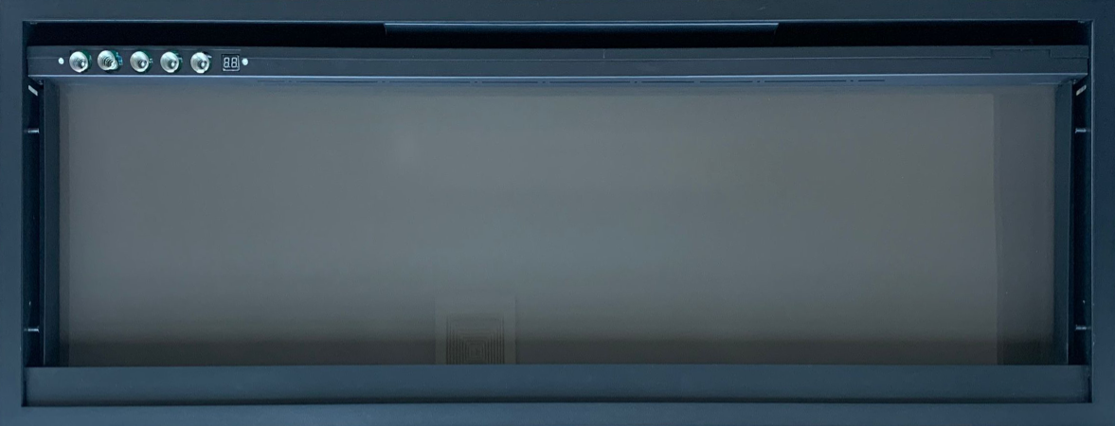
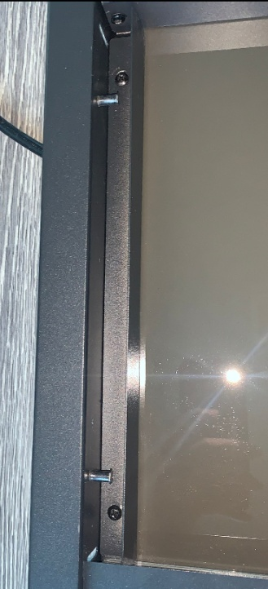
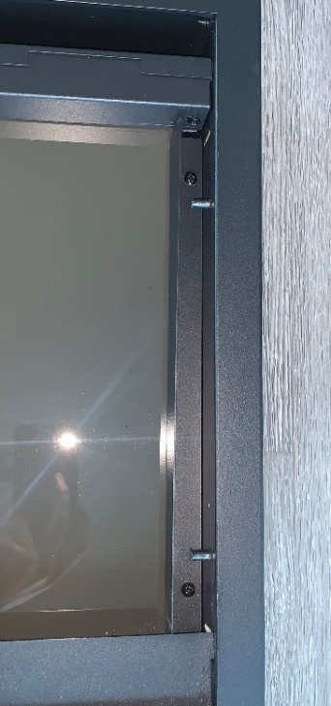
Step 2
Remove the screws on the left and right hand side to remove both back glass hold bars.

Slide 5
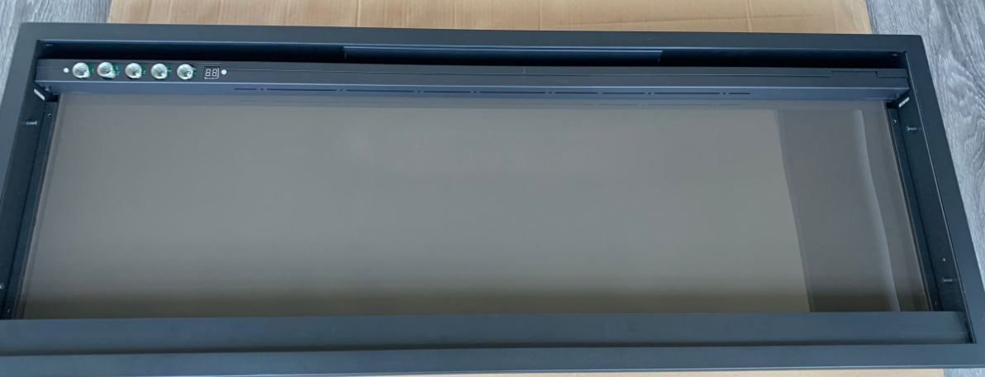
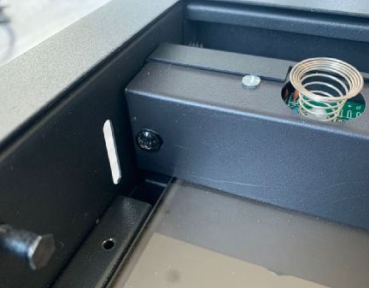
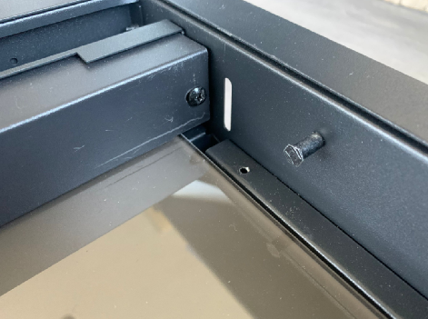
Step 3
Remove the screws on the left and right hand side

Slide 6
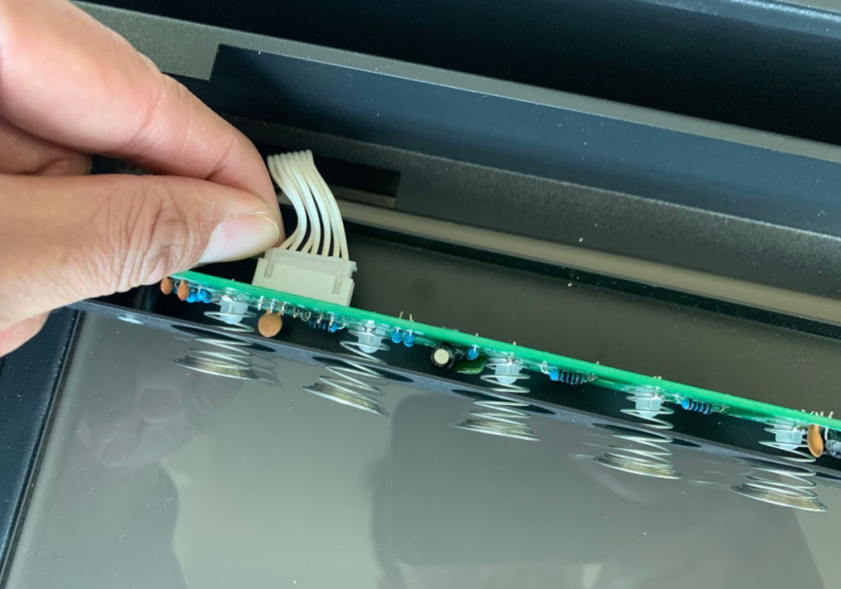
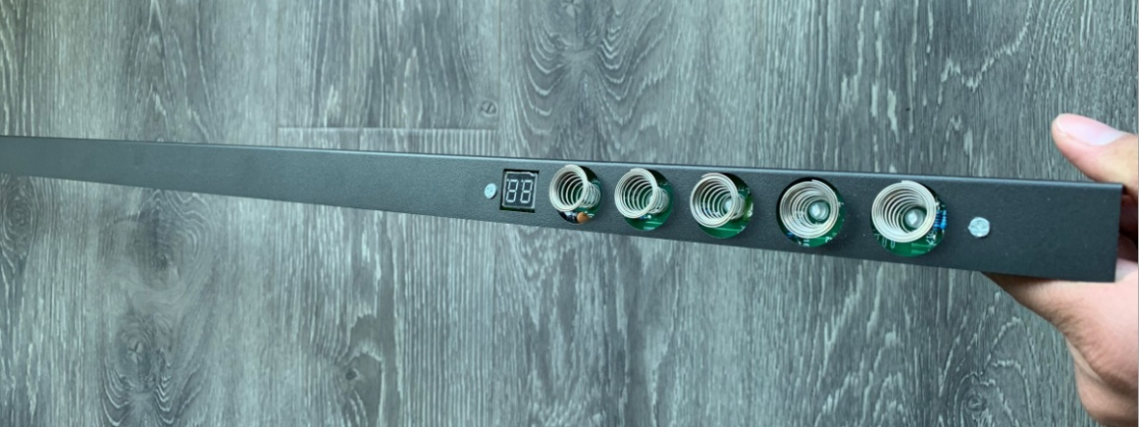
Step 4
Unbuckle the touch control panel and take off the touch control panel assembly.

Slide 7
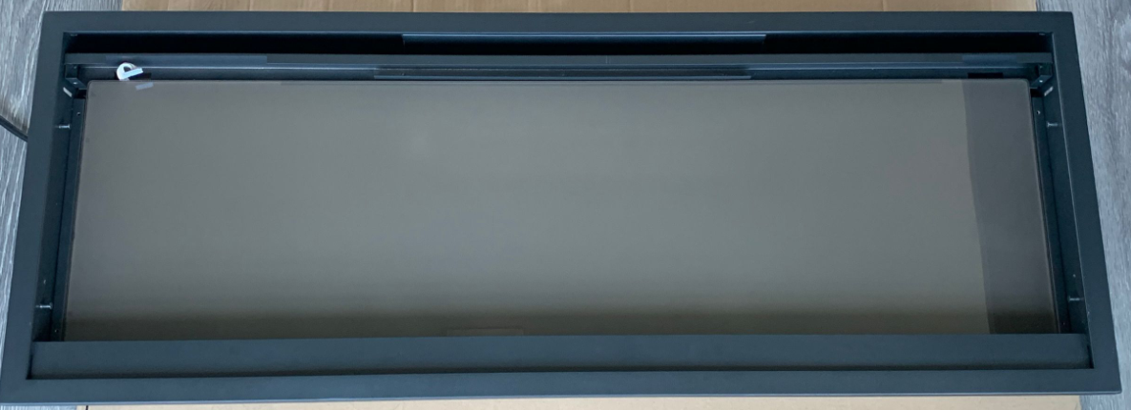
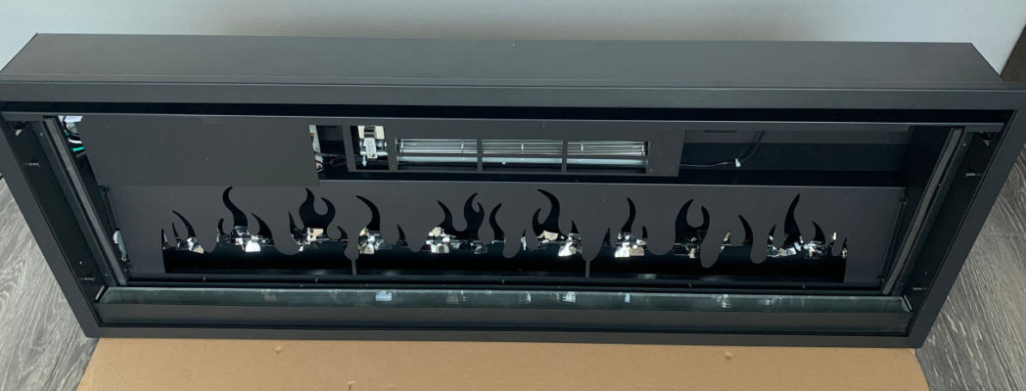
Step 5
Take off the back glass

Slide 8
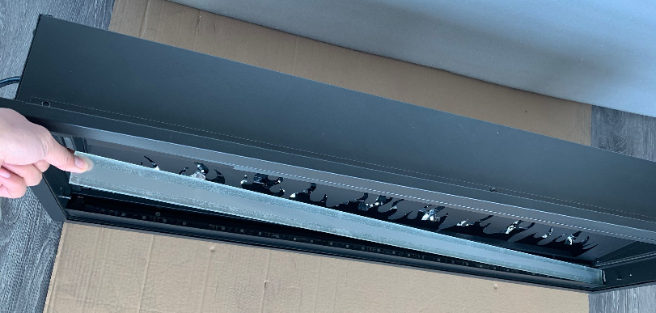
Step 6
Take off the tray glass.

Slide 9
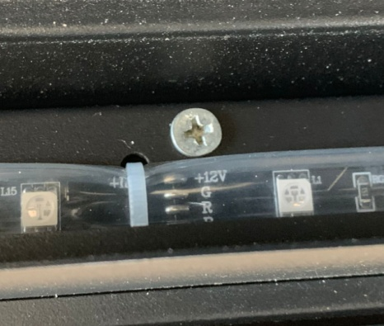
Step 7
Remove the screws to disconnect the tray light assembly from the fireplace

Slide 10
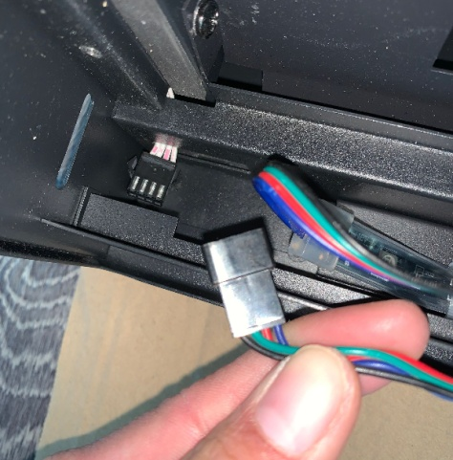
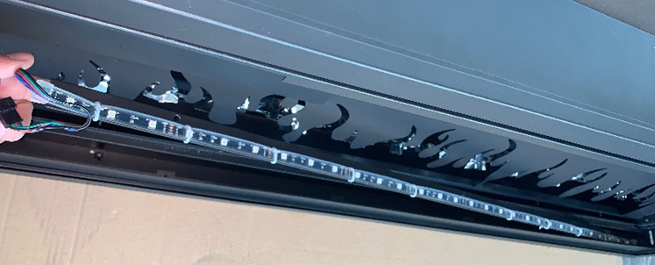
Step 8
Unbuckle the tray light to disconnect the tray light assembly from the fireplace, remove and replace with a new one.

Slide 11
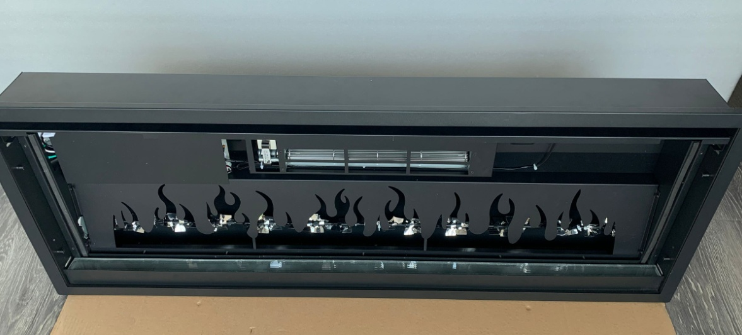
Replacing the flame light
Follow STEPS 1 to 5 from replacing the tray light, to arrive here

Slide 12
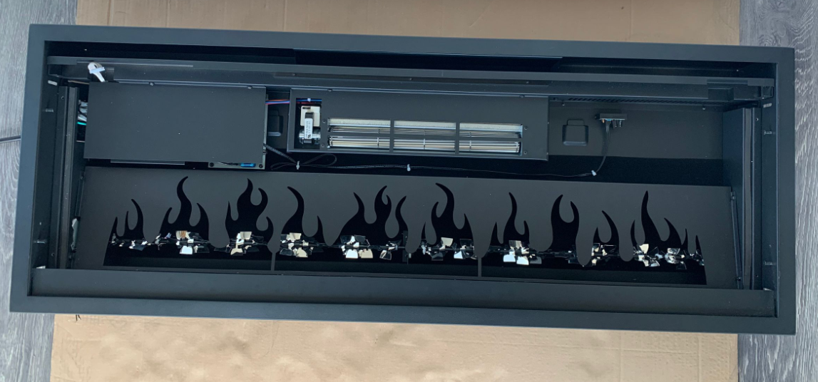
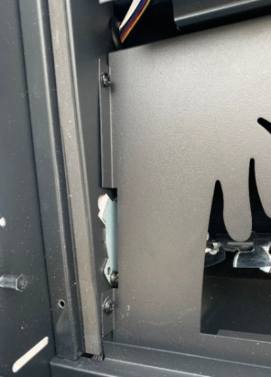
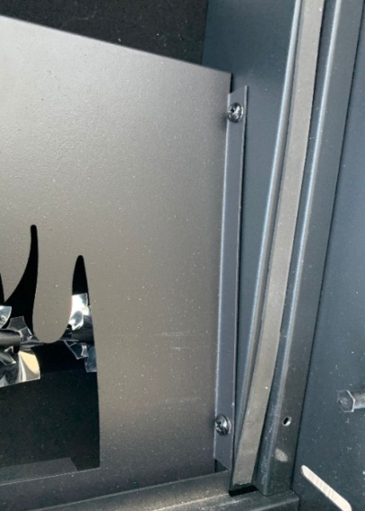
Step 1
Remove the 2 screws on the left and right side to take off the flame stencil.

Slide 13
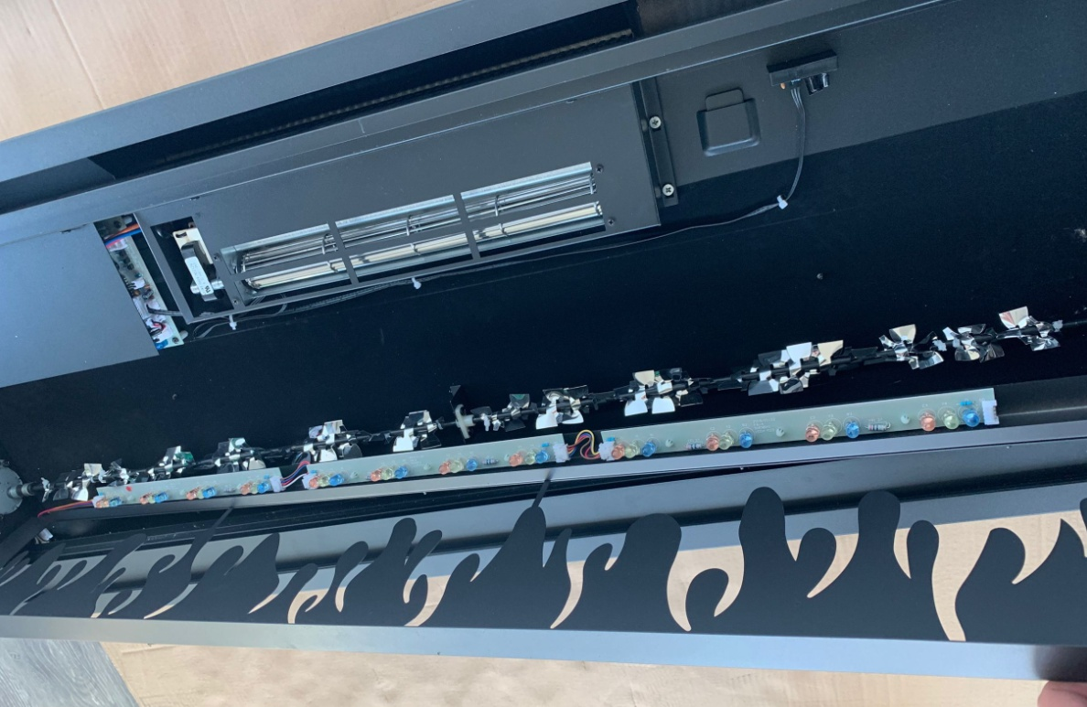
Step 2
The flame light is located at the back of the flame stencil. Now you can replace it with a new flame light.

Slide 14
Replacing the flicker motor
Follow STEP 1 to 5 in Replacing the tray light, to arrive here.

Slide 15
Step 1
Remove the screws on the left and right side to take off the flame stencil.

Slide 16
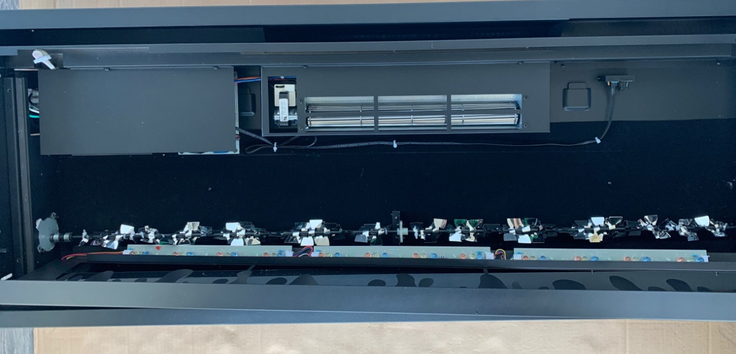
The flicker motor is situated here

Slide 17
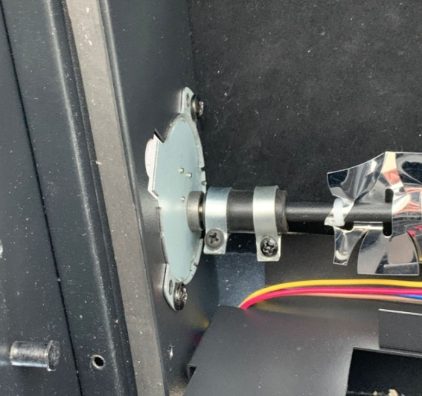
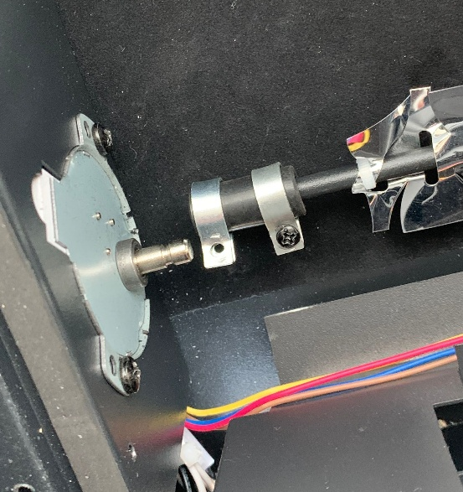
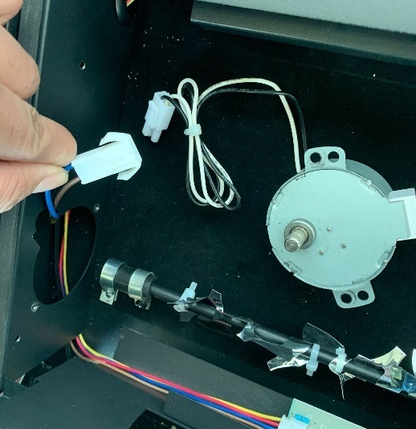
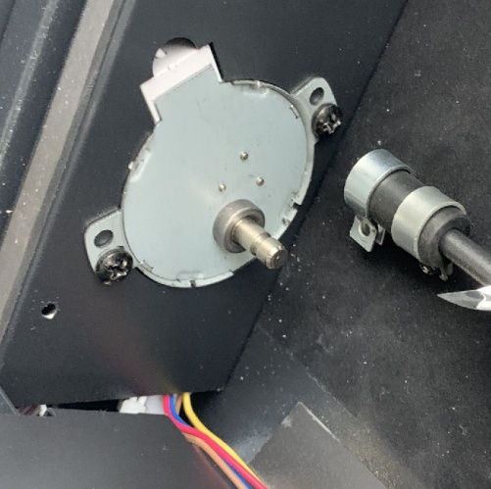
Step 2
Disconnect the motor from the rod
Remove the screw
Pull out the wiring and unplug the motor
Remove the screws to take off the motor

Slide 18
Replacing the heating assembly
Follow STEP 1 to 5 in Replacing the tray light, to arrive here

Slide 19
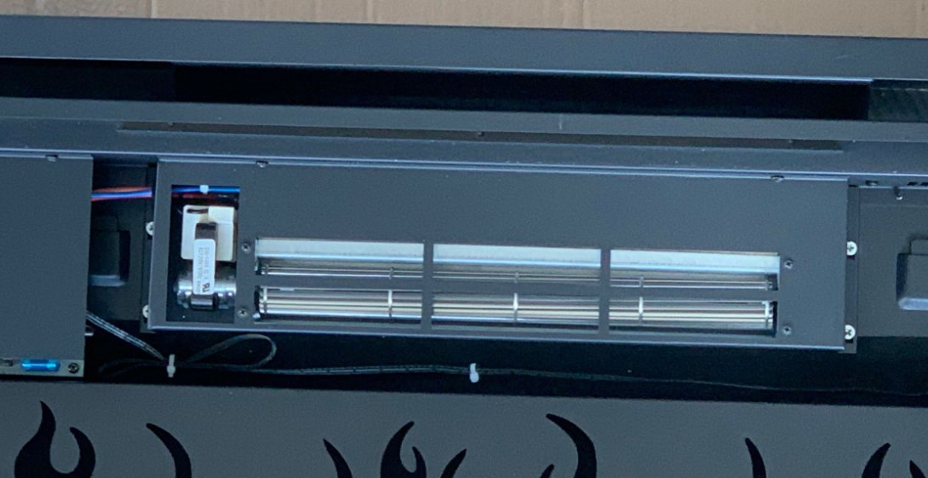
Step 1
Remove the screws to disconnect the heating assembly from the fireplace

Slide 20
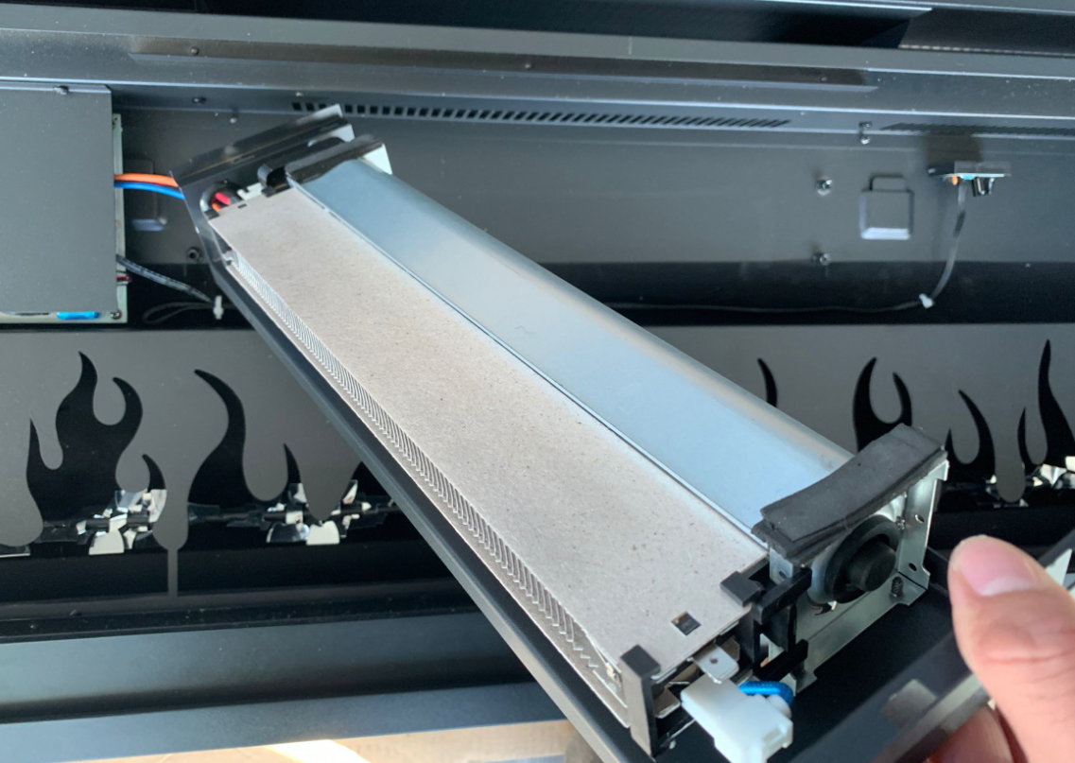
When the screws are removed, you can take off the heating assembly

Slide 21
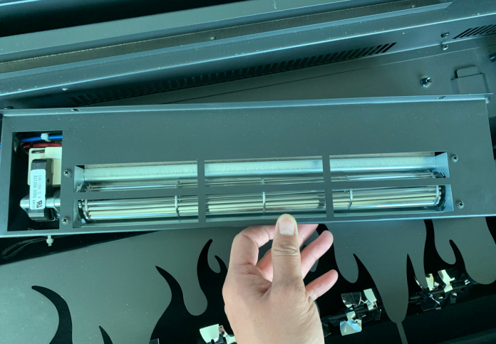
Step 2
Remove the screws to disconnect the heater from the heating assembly. Unplug to replace a new one.

Slide 22
Replacing the PCB board
Follow STEP 1 to 5 in Replacing the tray light, you arrive.

Slide 23
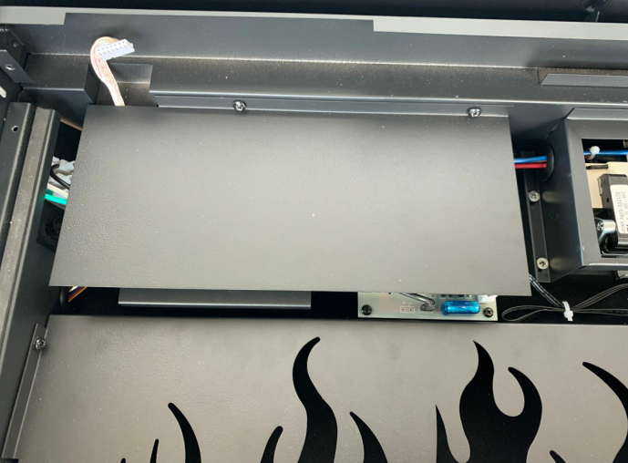
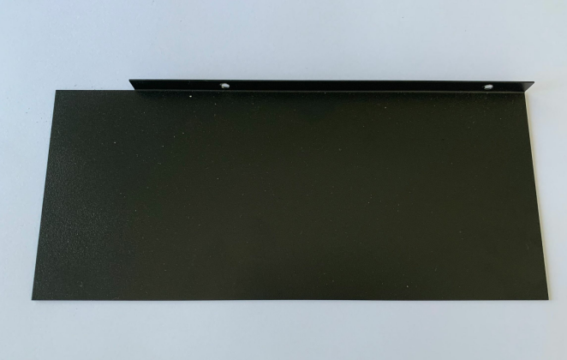
Step 1
Remove the screws to take off the PCB board protecting cover.

Slide 24
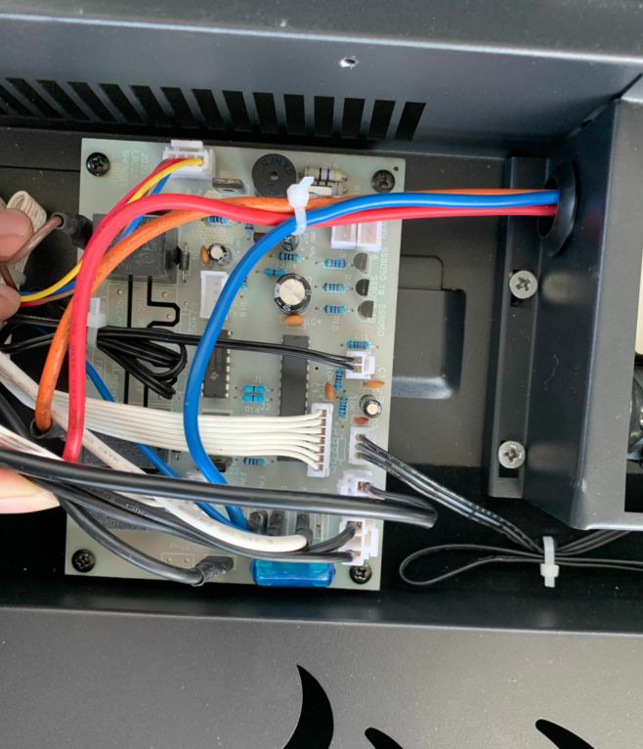
Step 2
Remove the screws to take off the PCB board to replace with it a new one.

Slide 25
Replacing the signal receiver
Follow STEP 1 to 5 in Replacing the tray light, to arrive here.

Slide 26
Step 1
Remove the 2 screws each on left and right side to take off the flame stencil.

Slide 27
The signal receiver is situated here

Slide 28
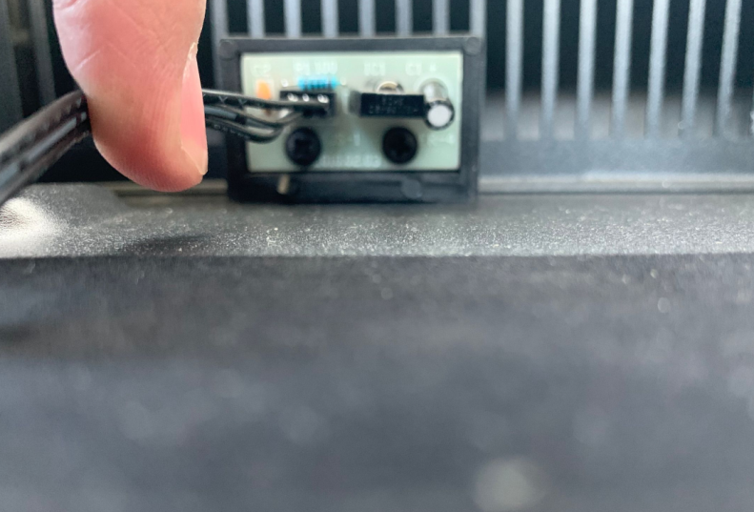
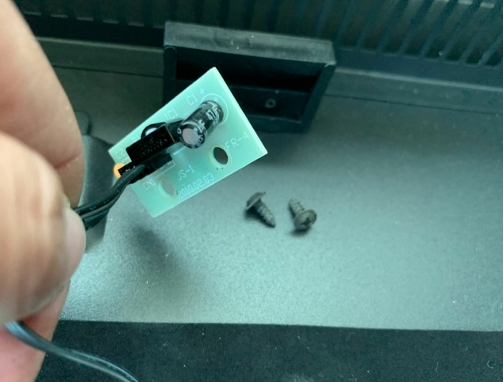
Step 3
Remove the screws to take off the signal receiver.

Slide 29
Step 4
Remove the screws to take off the PCB board protection cover.

Slide 30
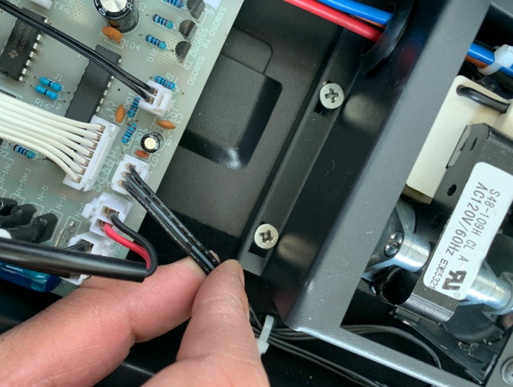
Step 5
Unplug and replace with it a new signal receiver

Slide 31
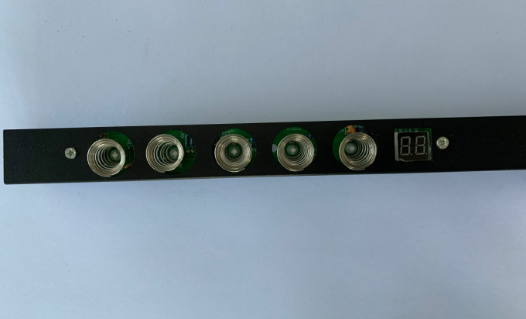
How to replace the touch control panel
Follow STEP 1 to 4 in Replace the tray light, you come to here.
Remove the screws to take the touch panel and replace it with a new one.

